Slide 1
FEB
1
What SN5 cost
2
What it is
COMPOSITES
3
One part, end to end
4
The traveler
5
Running the season
The SN6 workspace — what it does, how it's built, and what I need from you
6
Why it survives handoff
7
Limits and the ask
[Your name] · [Meeting date]
Live at feb-composites.web.app
Notes:
Keep this short. Name, why you're the one presenting it, and that the whole thing already runs — you'll be clicking into the live app twice. Say up front that the last slide is a list of four decisions you need from them, so they know where this is going and don't spend the walkthrough wondering.

Slide 2
01 WHAT SN5 COST
Three from the SN5 review
PP-01
Duratec
Days of mold time per incident, re-coating after sand-through.
PP-02
Customs
A ~109 lb Easy Composites order sat with no ETA. Rush replacements elsewhere: $120 of ACP rods, ~$400 to expedite.
PP-09
“What stack did we use?”
Asked in March about last year's seat. The tracker recorded intent, not what was actually laid.
Notes:
You were not here for these — say so, and say you are reading them off the SN5 review rather than diagnosing anyone's season. The facts are the credibility; the interpretation is not yours to offer. Land on PP-09: the first two cost time, the third is why they were hard to catch, because Slack is write-only memory. If someone says PP-02 was bad luck, the 5-why in pain-points.md gets to a UK supplier with multi-week customs lead time being treated like a next-day vendor — a process gap, not luck. The mechanism behind all three is turnover plus verbal training; they know that better than you do, so say it in one sentence and move on.

Slide 3
01 WHAT SN5 COST
10 pain points, root-caused, each mapped to a standard that fixes it
14 numbered standards, CS-000 through CS-013. CS-INDEX is the lookup.
tools/check_traceability.py audits that every pain point still points at a live standard.
Each one lands in the app as a step on a work order.
Notes:
The only standards slide before the ask — do not tour them. The bridge into the rest of the deck is the last line, and it is worth saying in full out loud: a standard sitting in a folder is a document, and the same standard wired into a buy-off step is a gate somebody has to pass. That is the whole argument for the app existing rather than just the standards.

Slide 4
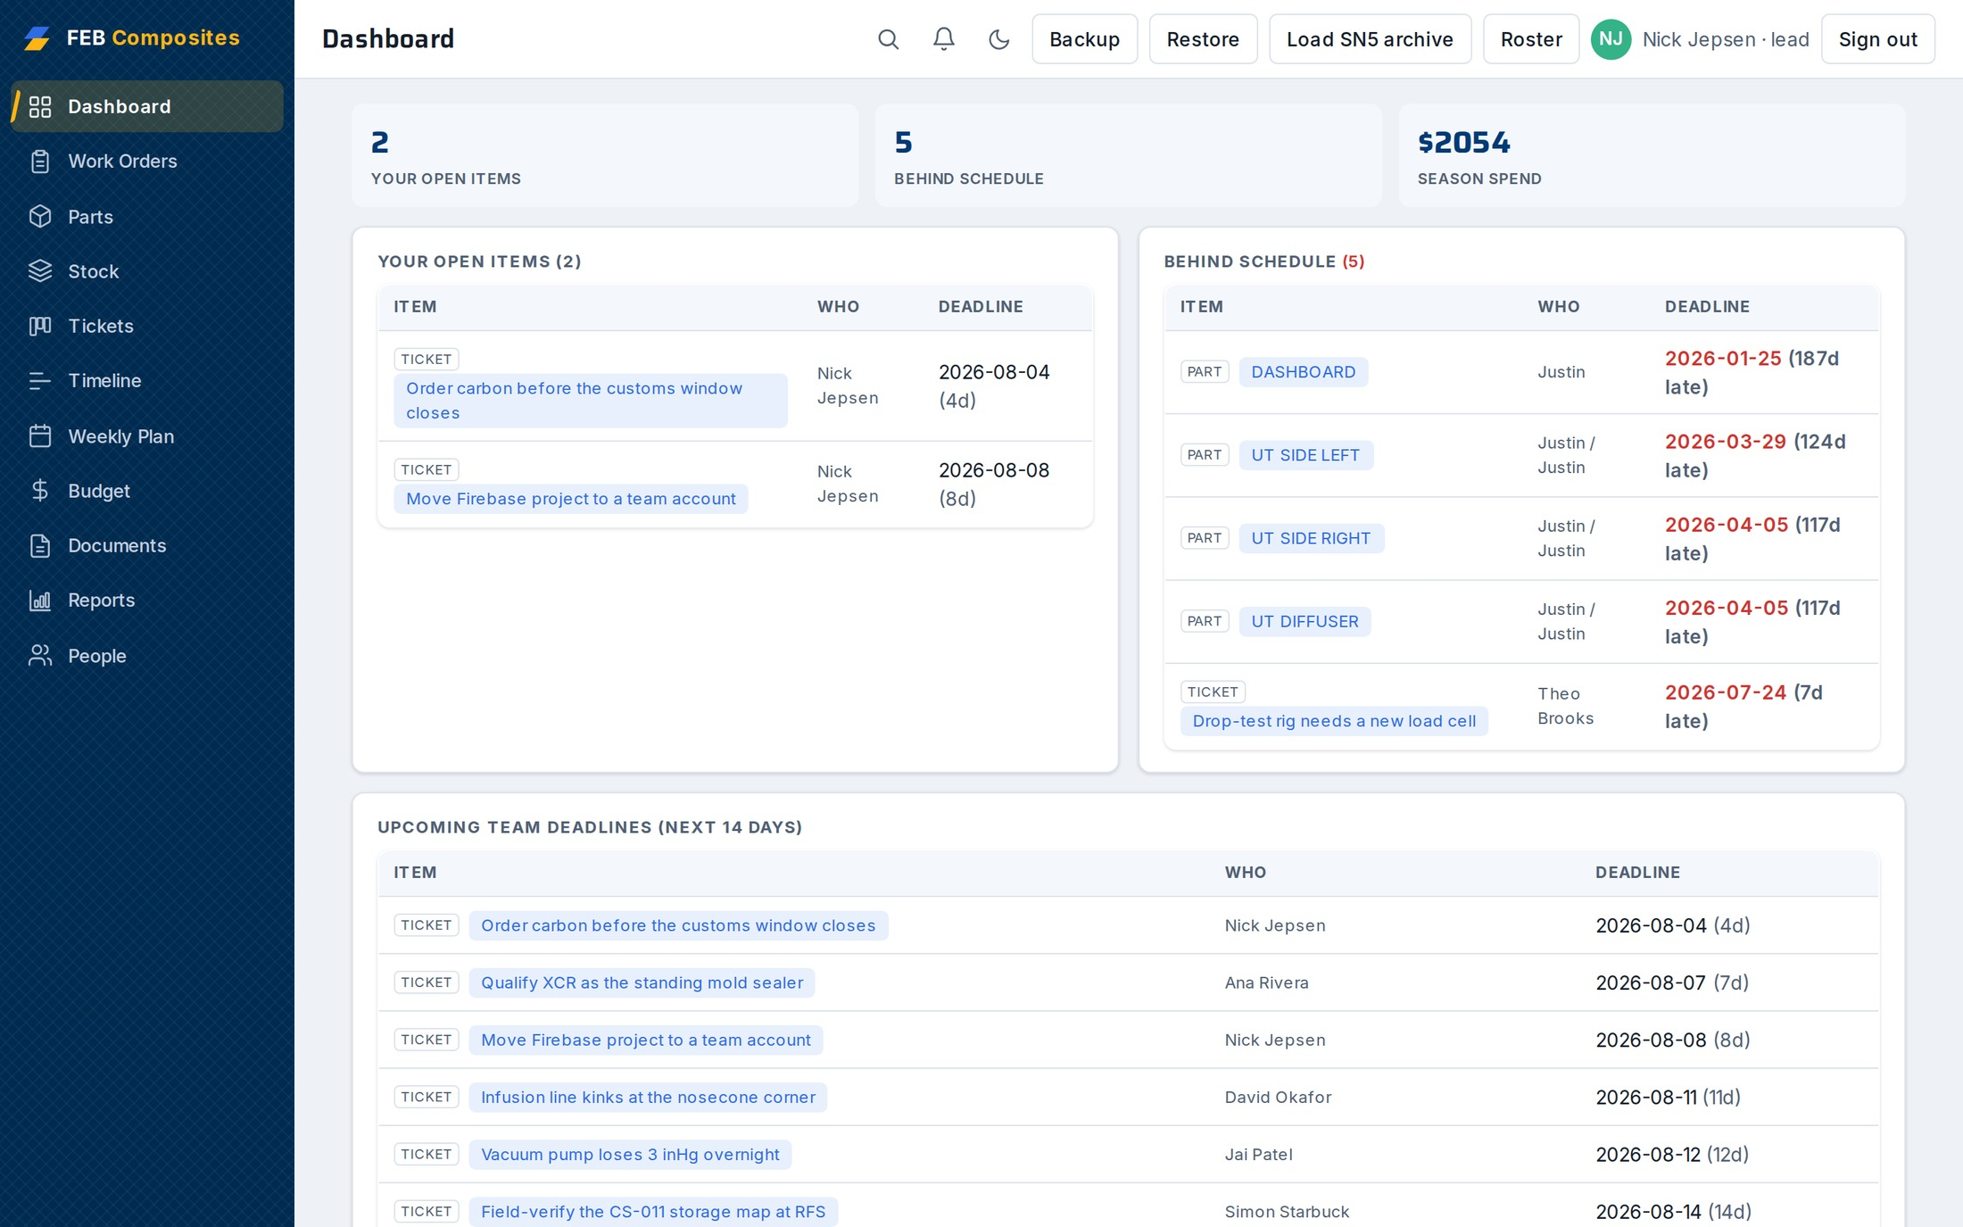
02 WHAT IT IS
One shared workspace, live for everyone at once
Free to run: Firebase Blaze with a $1–5 billing cap as the backstop.
Figures on these screens are seeded demo data, not real spend.
Notes:
Say once, here, that the figures on these screens are seeded demo data — the $2,054 tile and the purchase amounts later are not real spend. It costs a sentence and it protects every sourced number in the rest of the deck. Dashboard is read-only on purpose — every row is a link into the tab it came from. Say the URL out loud. If someone opens it on their phone right now, they will hit the login and see nothing, which is the next slide.

Slide 5
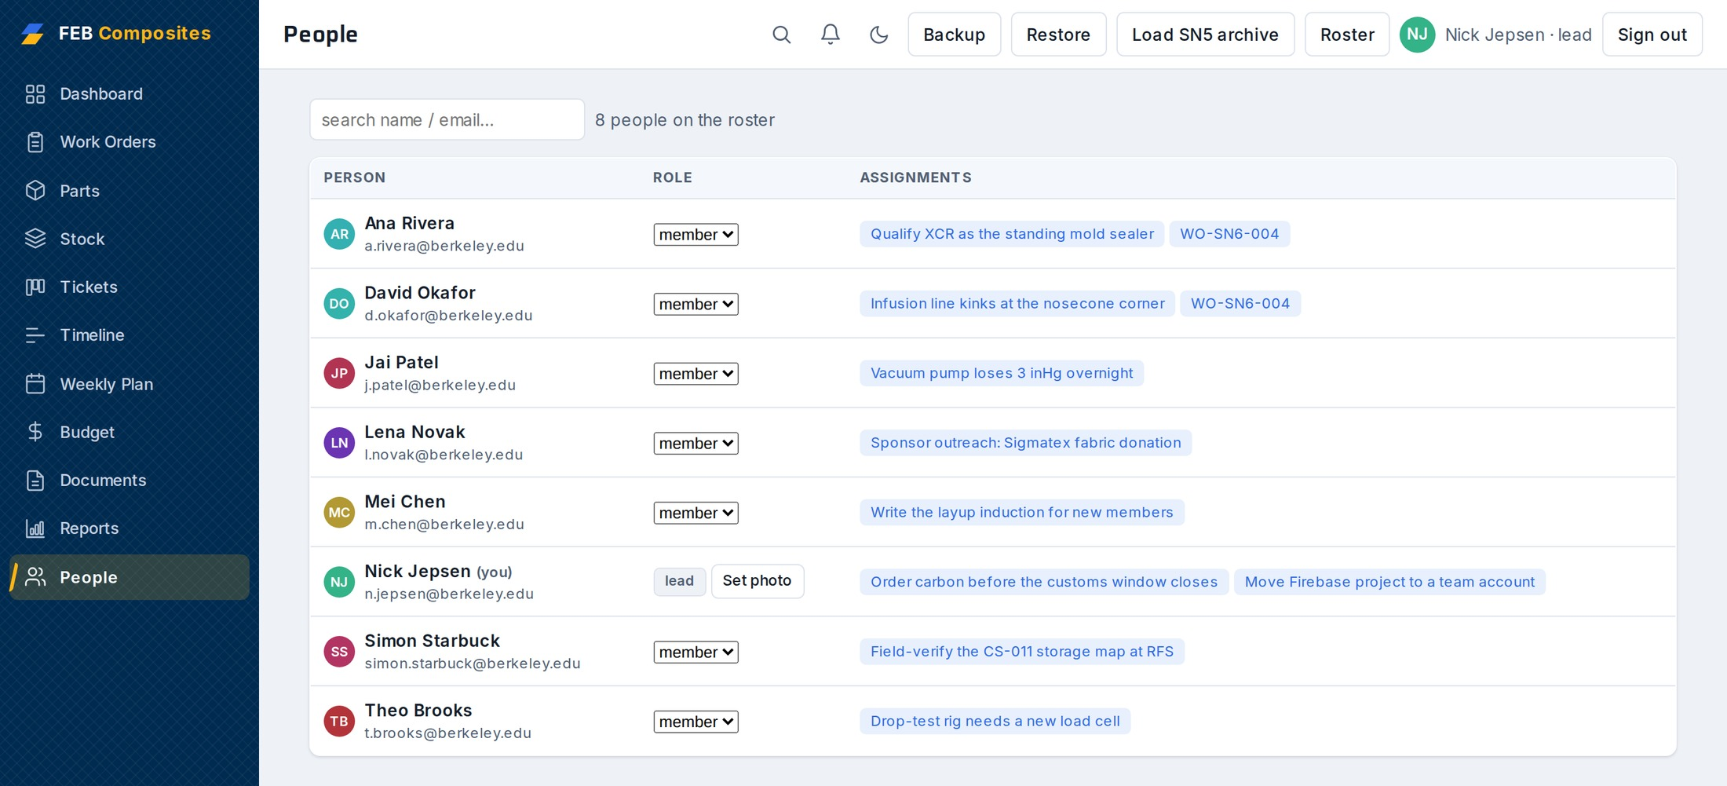
02 WHAT IT IS
An account gets you nothing until a lead adds your email
Enforced in firestore.rules, server-side — not by hiding buttons.
Roster self-edits are limited to name and avatar, so nobody can promote themselves to lead.
A member does the day-to-day work. A lead can also delete, restore from backup, and manage the roster.
Notes:
Worth being precise here because it is the question a lead actually asks: what stops a first-year deleting the season? Answer: deletes are lead-only and it is checked on the server, so it holds even if someone opens the console. Do not oversell it — see the limits slide; anyone on the roster can still edit any record.

Slide 6
02 WHAT IT IS
Eleven tabs. The rest of this is four of them.
→
Work Orders
→
Parts
→
Stock
→
Budget
Cross-links everywhere — click a chip to jump to the related record. ⌘K for global search.
Dashboard
Tickets
Timeline
Weekly Plan
Documents
Reports
People
Notes:
This slide exists so nobody spends the walkthrough wondering what they haven't been shown. Say it plainly: you are going to follow one part end to end rather than tour tabs, and the four highlighted are where that path goes.

Slide 7
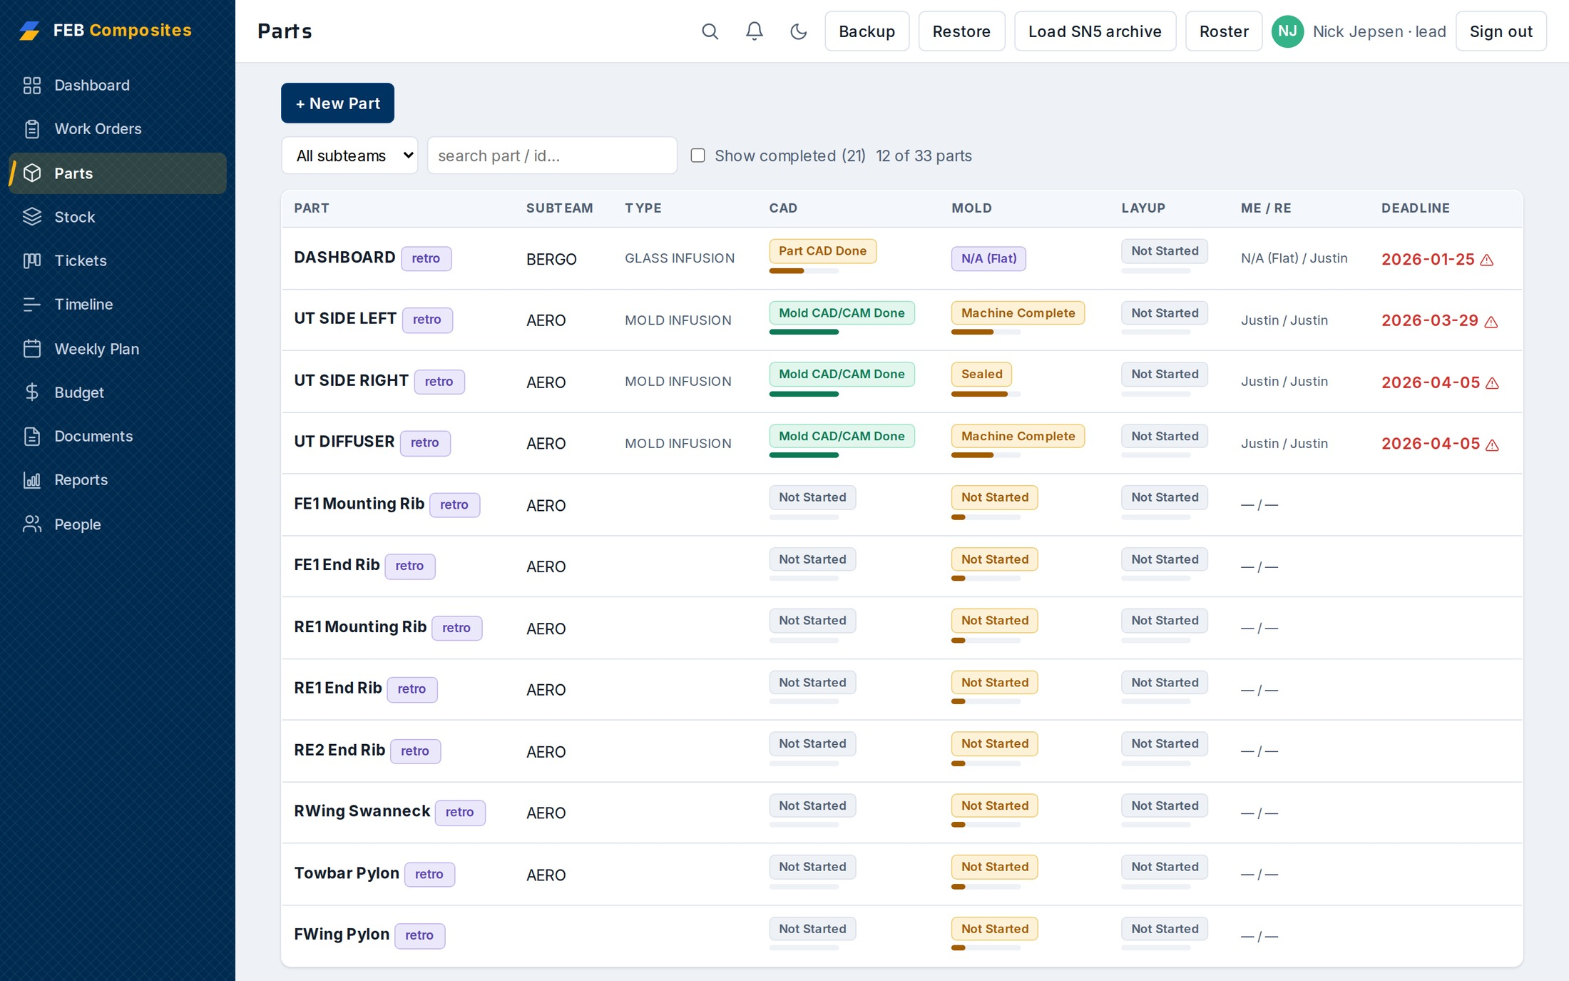
03 ONE PART, END TO END
CAD, mold and layup move independently, so the tracker shows three bars, not one percentage
Subteam, engineers, target weight, layup deadline.
A part's layup stack and its work order's stack stay in sync — edit either.
Notes:
The SN5 Part Tracker collapsed a part to one number and it was always wrong, because mold can be done while layup hasn't started. Three stages is the fix. This screen is the real SN5 tracker data, 33 parts.

Slide 8
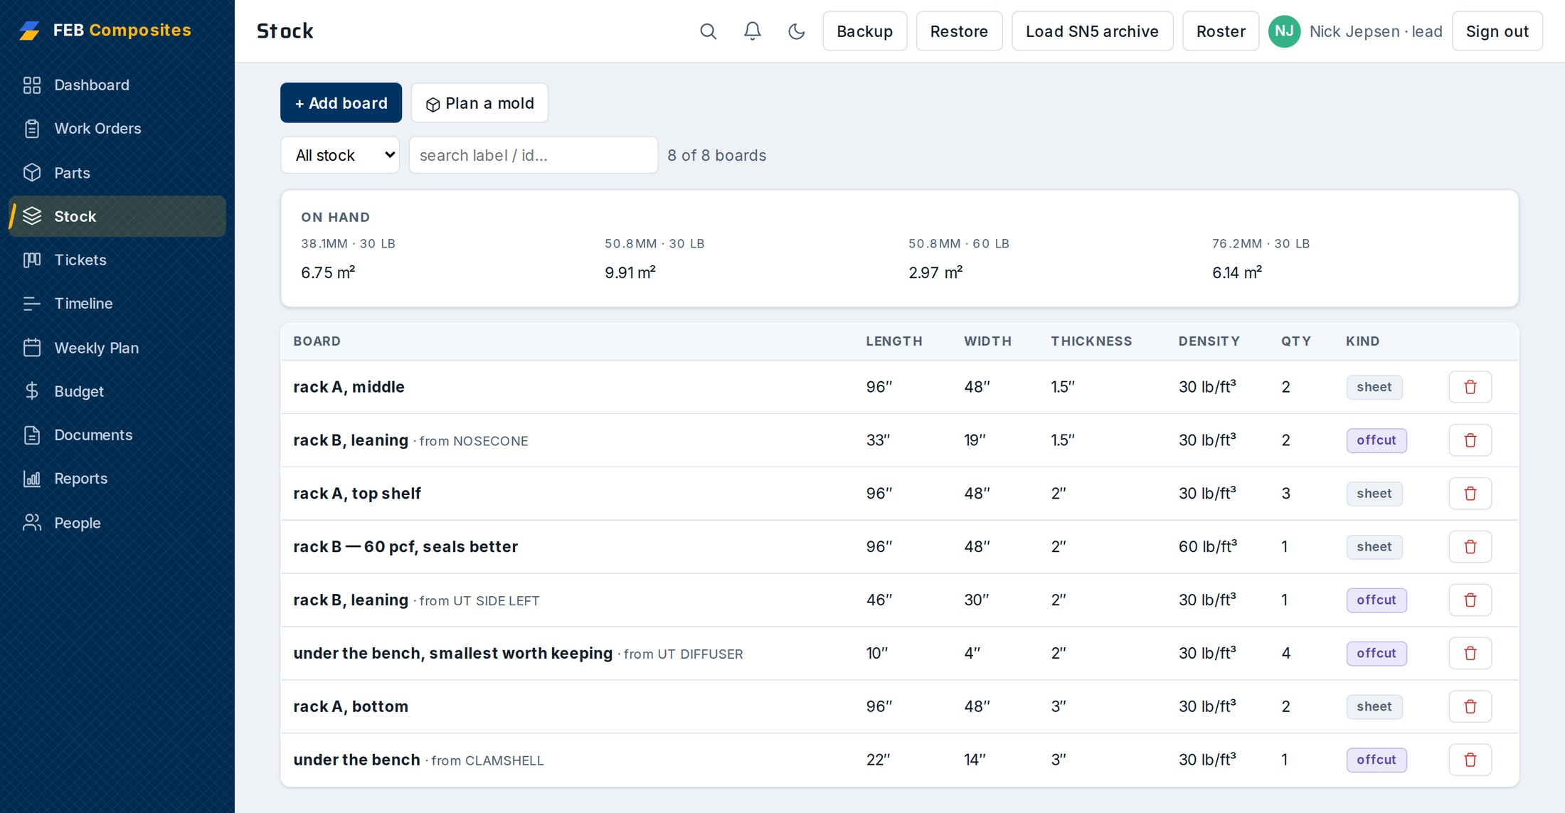
03 ONE PART, END TO END
A full sheet and an offcut are the same kind of record
So remnants come back into stock instead of piling up under the bench.
The planner picks thicknesses from what is actually on the rack — there is no point offering a stack we don't own.
Notes:
This is the small design decision that makes the rest work. If offcuts are a different kind of thing, nobody records them, and the planner ends up planning against fiction. Load SN5 archive brings in the rack SN5 left behind, so a fresh project has something to plan against on day one.

Slide 9
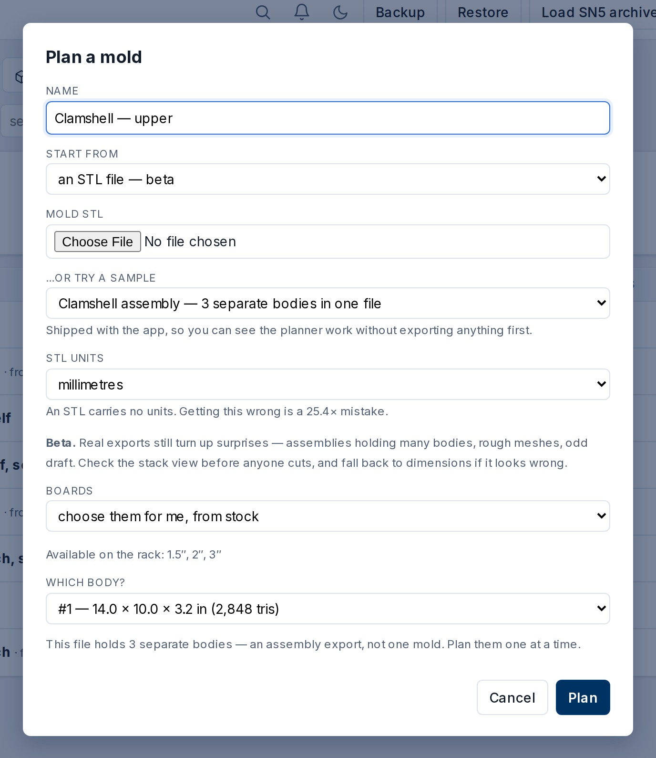
03 ONE PART, END TO END
A real Fusion export is an assembly. It asks which body you mean.
Rather than slicing the bounding box of everything and planning a void.
Three sample molds ship with the app, so the planner works before anyone exports anything.
Notes:
Small thing, but it is the difference between a demo and a tool. The sample shown holds three bodies. Mention the units line on that form — an STL carries no units, and getting it wrong is a 25.4x mistake, so the app makes you say.

Slide 10
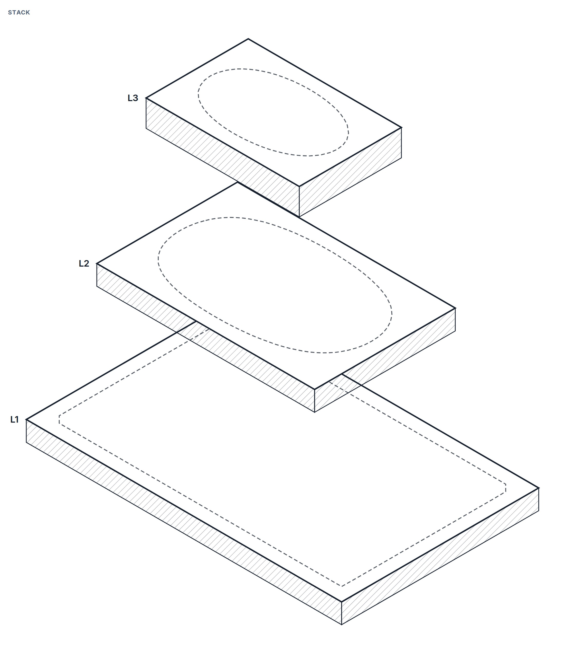
03 ONE PART, END TO END
Hand it a mold. It works out which boards to glue and how to saw them.
Thicknesses chosen to waste the least board, from the rack you actually have.
Tall molds split at the ShopSabre's ~6in cut depth, into one machine setup per section.
Notes:
This is the centrepiece — switch to the live app here if the room is with you. What is on the slide is the exploded stack: the dashed outline on each layer is the mold, traced from the stored STL. What is NOT on the slide, and is worth clicking to, is the 3D view above it on the same page — the actual mold sitting inside the translucent blocks. Before that existed the reviewer only ever had the dashed outline, and signing off the CS-003 §7.2 fit review was an act of faith. Drag to rotate; pinch works on a phone at the bench, which is where the sign-off usually happens.

Slide 11
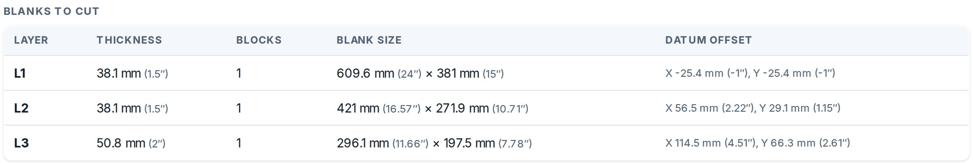
03 ONE PART, END TO END
The blocks come back out as CAM stock
Export stock STL writes one file per machine setup, in millimetres, at the mold's own CAD origin.
It drops onto the model in CAD with nothing to align, so CAM uses it as the stock body directly. Marked beta.
Notes:
The origin detail is the whole value: an export that lands anywhere else means someone re-models the stock by hand, which is what we were trying to avoid. Beta is honest — say it. It has not been through a full machining cycle yet.

Slide 12
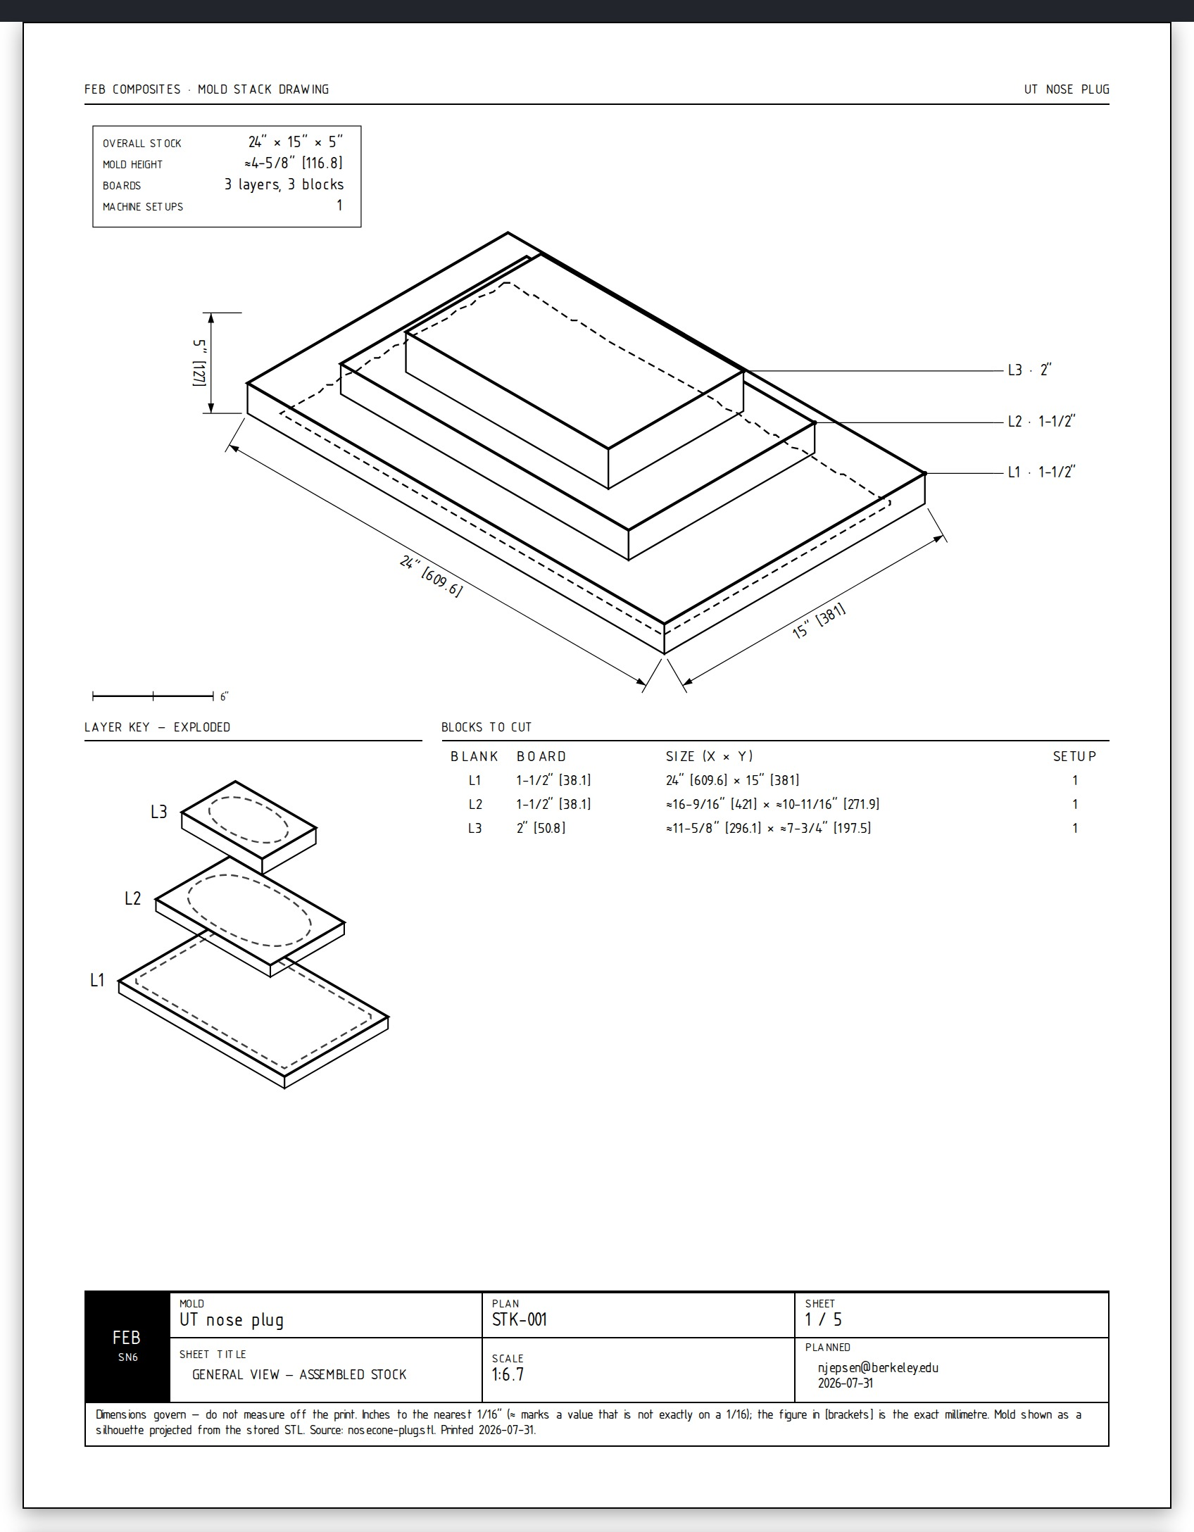
03 ONE PART, END TO END
The boards get glued by hand, so it prints a dimensioned sheet per layer
Whoever is holding layer 3 needs to know how far in from each edge of layer 2 it goes.
Inches to the nearest 1/16in with the exact millimetre bracketed. Every sheet marks the same datum corner.
Notes:
Per-side insets off the board below, PLUS an absolute datum table — because a board sawn oversize makes every edge-relative number wrong in the same direction, and the datum is how you catch it. A value not on a 1/16 gets an approximately-equals sign, so the fraction never gets read as the truth. The mold silhouette is traced off the stored STL, not drawn.

Slide 13
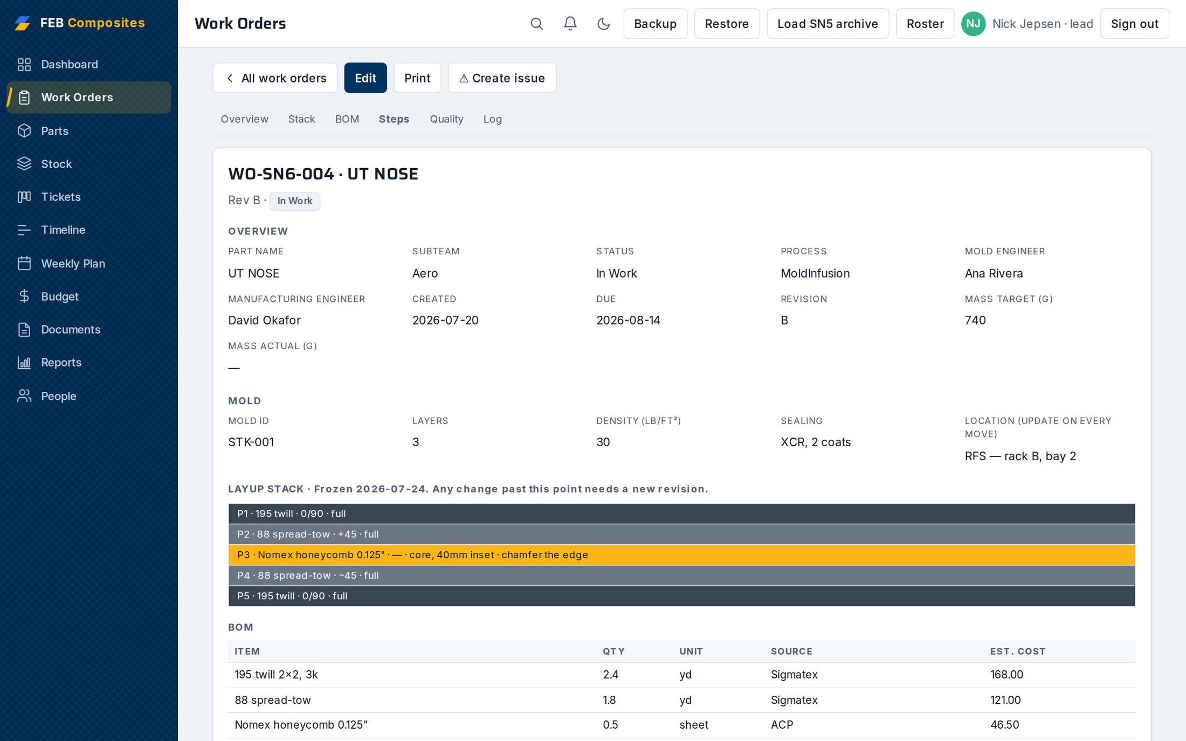
04 THE TRAVELER
The traveler carries the stack, the BOM and the standard each step answers to
Stack frozen at a revision — any change past that point needs a new one.
Every step cites the CS clause it comes from.
Notes:
This is a live SN6 record, not the retro archive. Point at the frozen-stack line: PP-04 was a part remade three or more times because no frozen thickness or DXF was shared between subteams. Freezing it at a revision is the fix.

Slide 14
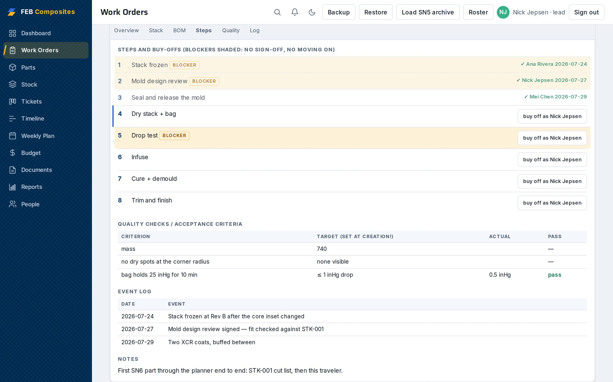
04 THE TRAVELER
Buy-offs carry a name, and blockers hold the line
Stack freeze, mold design review and drop test are blockers: later steps stay locked until they're signed.
It records who was signed in. It does not prove who held the part, and a roster member can still edit the record afterwards.
Notes:
The boundary is on the slide on purpose — it is the lead's first real question and it should not wait until the limits slide. Say what it closes: 'nobody knows who did this', not 'somebody falsified this'. If pressed on why it isn't tamper-proof, the honest answer is that version history and per-record locking are real work nobody has done yet, and the monthly JSON export to Drive is the audit trail in the meantime.

Slide 15
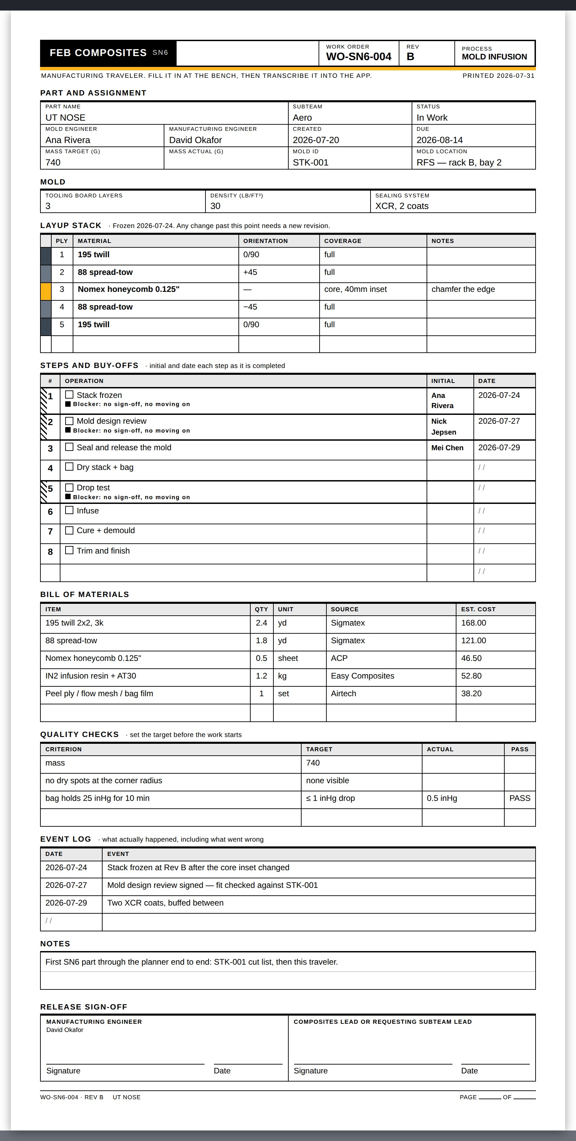
04 THE TRAVELER
It measures the sheet before it prints it, to hold a two-page traveler
The app renders the sheet, measures what the browser actually laid out, and steps down through tighter layouts until it fits.
Blank travelers for the bench. Always black-on-white, whatever theme you're in.
Notes:
A third page means the back of the sheet is somewhere else and the buy-off columns get lost. Worth one line on why this was hard: a sheet is 8.5in — 816 CSS pixels — so on a phone the browser blew the viewport out to contain it and parked the Initial and Date columns off the right edge. It fits the sheet to the screen now, and forces full size when it actually prints.

Slide 16
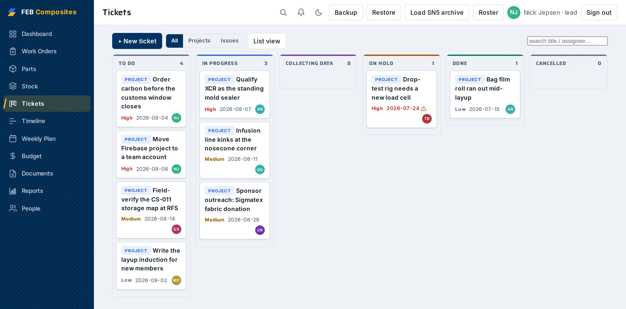
05 RUNNING THE SEASON
Everything that isn't a part lives in Tickets
R&D, process fixes, bugs, outreach. Board or list, assignees, watchers, sub-tickets.
Cross-linked to the parts and work orders they touch.
Notes:
This replaced two separate things that were the same thing — Projects and Issues. Comments take real formatting and photo attachments, which matters because most of what goes wrong is easier to photograph than describe.

Slide 17
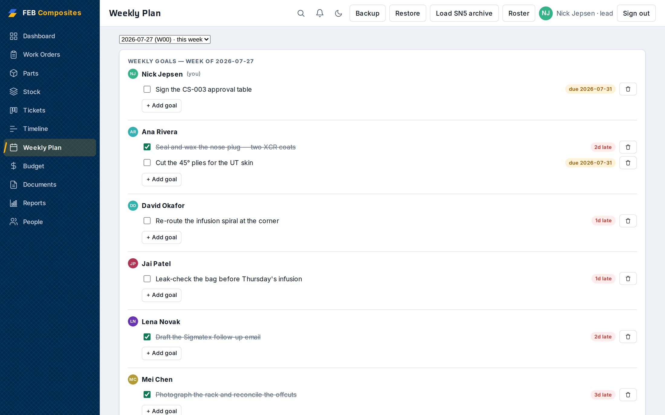
05 RUNNING THE SEASON
The weekly plan pulls each person's tasks from their ticket due dates
Plus carpools — who's driving to RFS, when, and how many seats are left.
Logistics stop living in one person's head, or in a thread that scrolls away.
Notes:
Carpools sound trivial and are not: RFS is a drive, and a layup that misses its slot because the ride fell through costs the same as one that fails. This is a second view over the same schedule as the Timeline tab, not a separate plan to keep in sync.

Slide 18
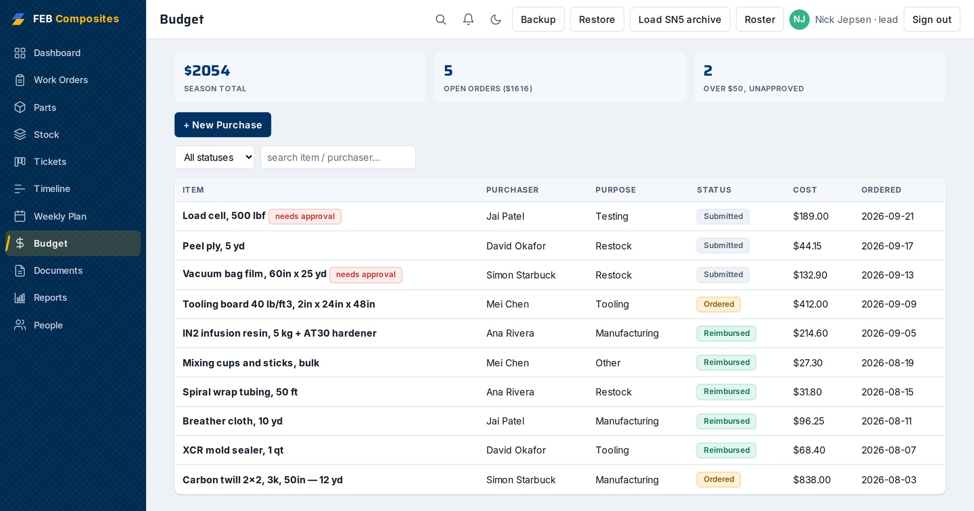
05 RUNNING THE SEASON
Purchases run Submitted, Ordered, Reimbursed
Anything over $50 is flagged for approval, per CS-012.
SN5 ran about $5.3k through one person's personal card — the totals on this screen are demo data.
Notes:
The scan-receipt button opens the phone camera directly and attaches the photo to the purchase — no OCR, nothing clever, just the photo taken where the receipt is. This slide usually gets the most nodding from whoever has been fronting the money.

Slide 19
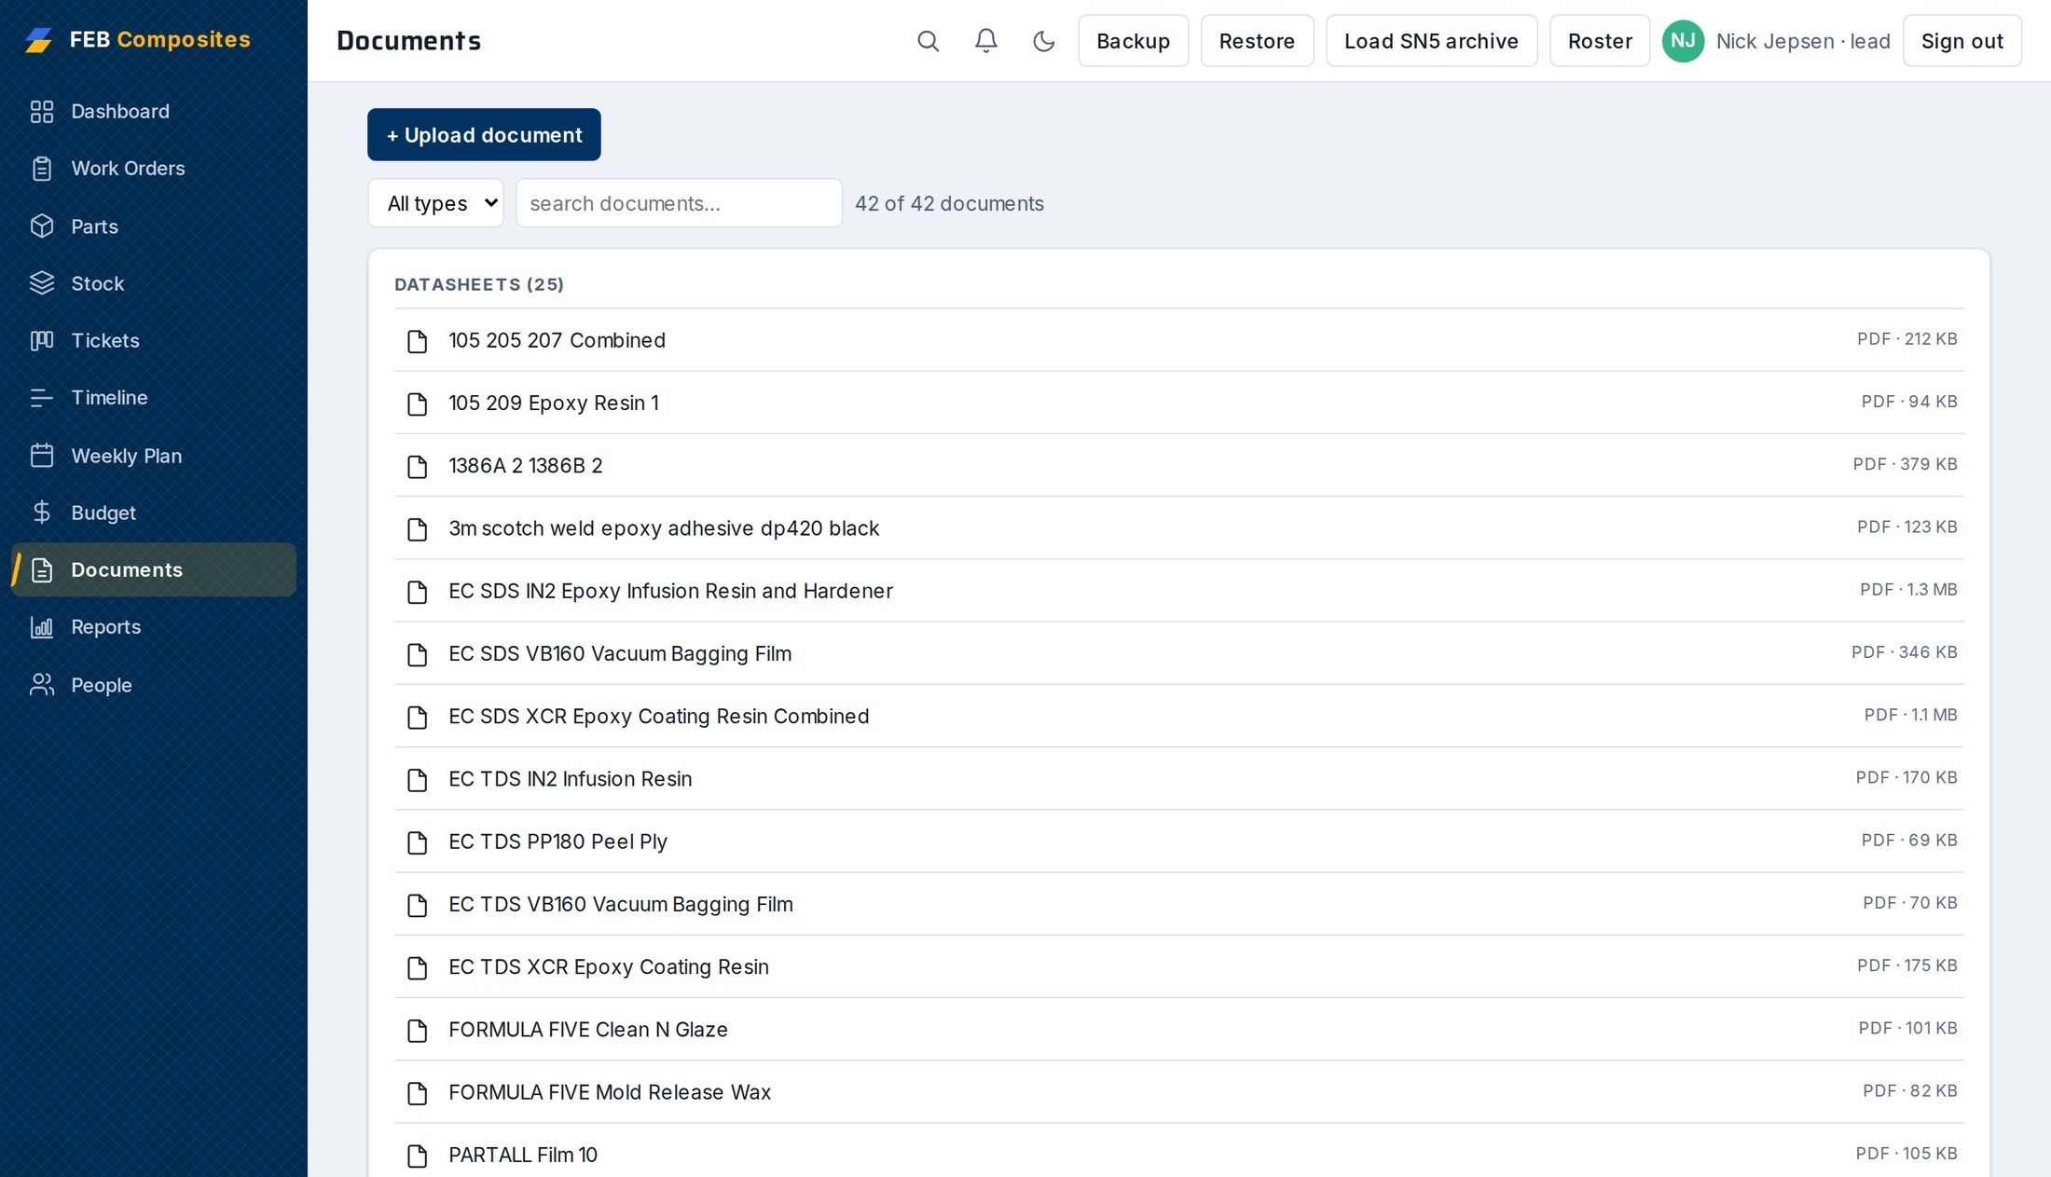
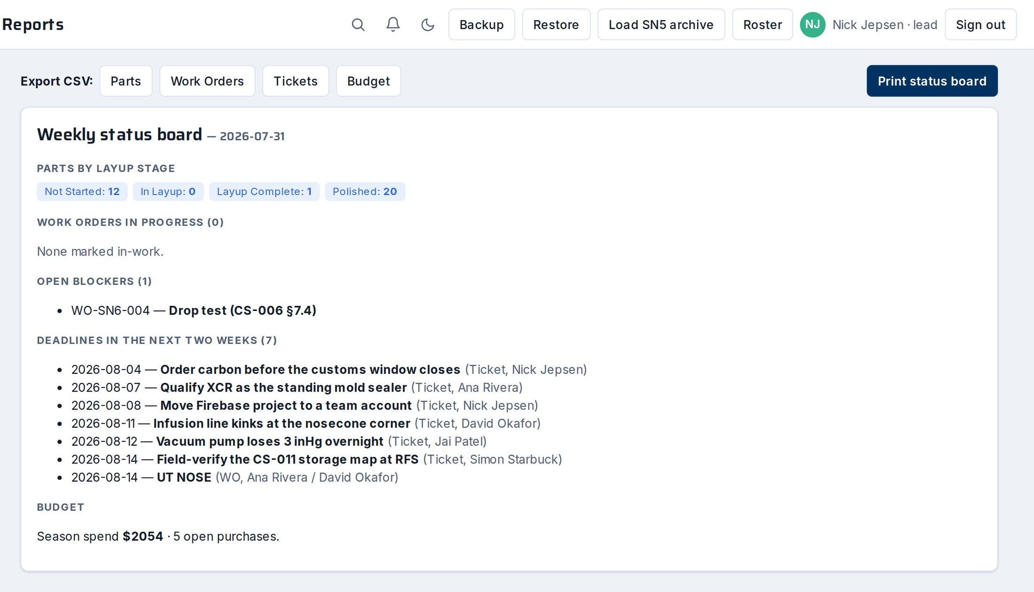
05 RUNNING THE SEASON
Every reference doc in the app
Documents
Reports
25 manufacturer datasheets, the CS standards rendered from source, and the shop printables. Filterable. Anyone can upload.
CSV export per dataset, plus the Monday-meeting status board as a single printable page.
Notes:
The datasheets being in the app rather than a Drive folder is the difference between checking a mix ratio and guessing it. Reports exists so the Monday meeting stops being someone rebuilding a summary by hand every week.

Slide 20
06 WHY IT SURVIVES HANDOFF
Built to still run in two years
0
build steps
No framework, no bundler — 24 plain script tags. Open the file and it runs.
1
dependency
DOMPurify, SRI-pinned and self-hosted after shop wifi silently degraded it from a CDN.
8,900
lines of app source
Small enough that the next lead can read it. The 3D viewer is hand-rolled WebGL with nothing behind it.
Two of the test suites render the real thing in a browser and measure it: every drawing sheet across 8 mold fixtures, checked for legibility down to a 5.5pt floor, and the whole app booted at 4 device widths with every printable opened.
Notes:
Two arguments, and they are the same argument. First, the build: not that vanilla JS is better, but that a student team cannot carry a dependency tree that rots — a framework upgrade nobody is around to do is how these tools die two seasons later. The old single-file work-orders.html is still in the repo and opens any exported JSON with no server at all. Second, the tests: everything else in the repo asserts on strings and numbers, and a sheet passes all of that while printing a dimension straight through a dimension line, or running off the side of a phone. Both of those shipped once. That is why two suites render in headless Chromium and measure what the layout actually did. Plus the Firestore rules run under the emulator, and the app test is 1,917 lines across every tab.

Slide 21
07 LIMITS AND THE ASK
What it does not do
Buy-offs are not tamper-proof
They record who was signed in. Any roster member can still edit any record, and there is no in-app version history. Monthly JSON exports to Drive are the audit trail.
Notifications are in-app only
Watcher unread state lives in one browser. It does not sync between devices and it does not email.
Four standards are outlined, not drafted
CS-001, CS-007, CS-008 and CS-009. Outlined means the structure is there and the content isn't.
STL export is beta
Real exports still turn up surprises. Check the stack view before anyone cuts.
Notes:
Say this slide slowly and do not soften it. A lead who finds a limitation themselves after adopting it stops trusting everything else you said. Every one of these is written in the repo's own README already — you are reading it out, not confessing.

Slide 22
07 LIMITS AND THE ASK
Four decisions
WHO
01
Adopt it for SN6
Roster everyone in week 1, so it is the one place the season is written down.
Week 1
02
Move the Firebase project
feb-composites sits on a personal Google account. It has to move to a team account, or it is one graduation away from gone.
Before SN6 kickoff
03
Sign the CS approval tables
All 14 standards ship “Draft, pending Lead signature”.
Sept
04
Field-verify CS-011 at RFS
The storage map was written from records, not from standing in the room.
Sept
feb-composites.web.app
Notes:
Stop talking after this. The second one is the one that actually matters and is the easiest to defer: the Firebase project is on a personal Google account, so it is one graduation away from being unreachable. Ask for a name and a date on each, in the room. If you only get one, get that one.

